Slide 1
DELHIVERY ADVERTISEMENT EVALUATION
Submitted By: Chaitanya Giri Goswami
Registration Number: 12411084

Slide 2
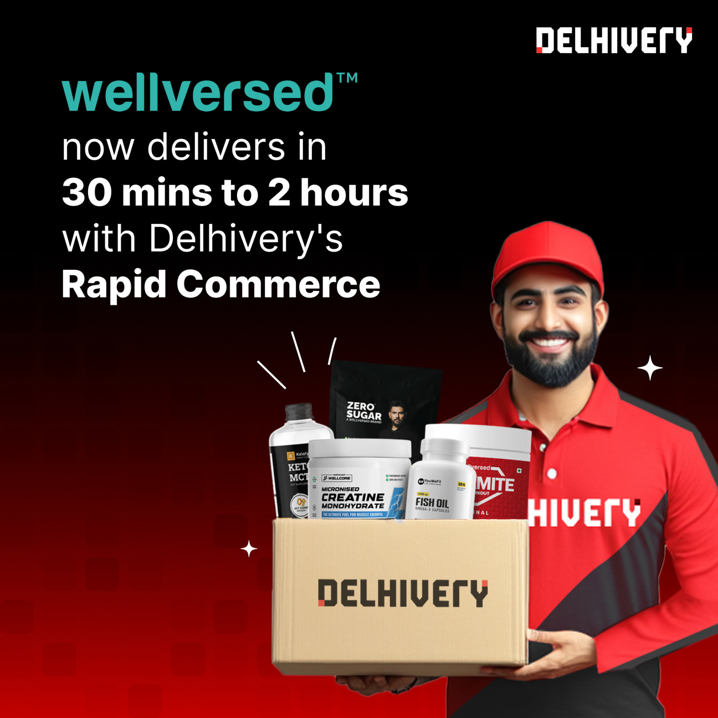


Slide 3
ADVERTISEMENT REVIEW
Purpose: The ad highlights fast delivery (30 mins–2 hrs) of health and nutrition products, aiming to attract busy, health-conscious customers.
Tool Used: It uses digital advertising as part of its IMC strategy to create brand awareness and promote convenience.
Design Elements: Strong visuals, clear branding, and a delivery person image help build trust and quickly communicate the service offered.

Slide 4
STRENGTHS
Clear Messaging: The ad communicates the service promise directly and efficiently — quick delivery of health supplements.
Strong Visual Appeal: The professional design, bold fonts, and clean layout grab attention and create a reliable brand image

Slide 5
WEAKNESSES
Lack of Specifics: It doesn’t mention coverage areas or limitations, which could mislead customers about availability.
Over-Reliance on Visuals: The poster assumes familiarity with the products; new customers may not understand what "Wellversed" offers.

Slide 6
ETHICAL ISSUES
Potentially Misleading: Claiming "30 mins to 2 hours" delivery might create unrealistic expectations if service isn't available in all locations.
Stereotyping: Featuring only one male delivery agent may unintentionally reinforce gender roles in delivery services.

Slide 7
SUGGESTION FOR IMPROVEMENT
Include a small disclaimer or link for serviceable areas and terms of delivery to manage consumer expectations more transparently.

Slide 8
THANK YOU!

